Slide 1
Sprague Avenue Phase II Survey Results and Next Steps
Brandon Blankenagel, PE
Integrated Capital Management

Slide 2
Sprague Avenue Projects
U-District Bridge
Under Construction
Sherman Plaza
2018 Construction
Phase 1-Completed 2017
Phase 2-Start 2019
Grind & Overlay in 2018
Future Projects

Slide 3
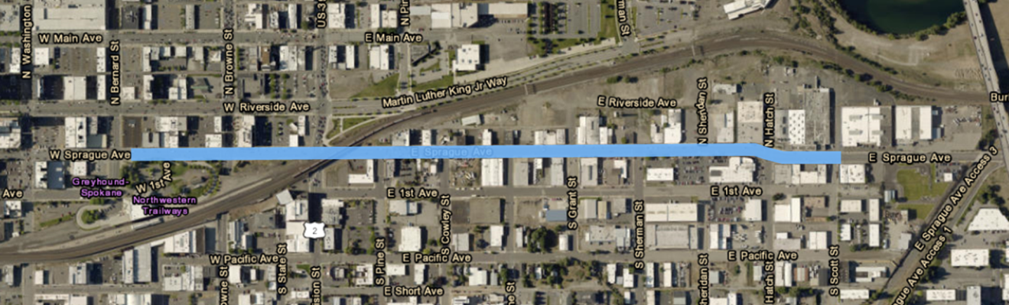
Project Background
Bernard Street to Scott Street
Concepts shared with public and business/property owners in April with online open-house.
Public Survey available through April 30th.
Certified Mailer to business and property owners due May 15th.

Slide 4
Certified Mailer Outcomes
+1*
+2*
*self identified in
online survey

Slide 5
Online Survey Results
Open April 2 – April 30
145 Responses (includes 16 business/property owners and 139 citizens)
3 basic questions:
3 optional layouts for Division to Sherman
2 alternatives for Bernard to Division
Support adding parking on side streets

Slide 6
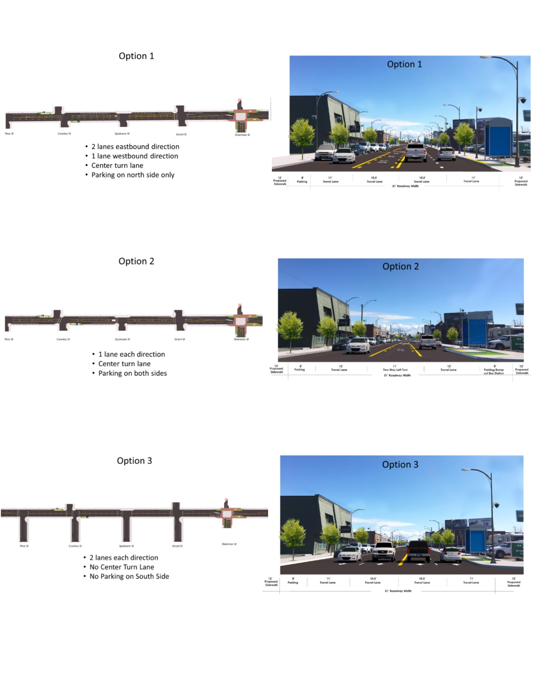
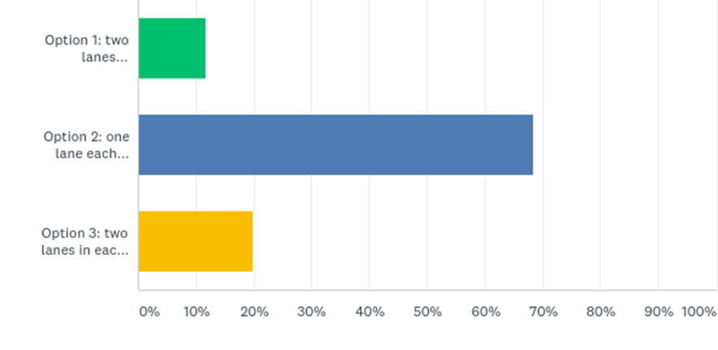
Q1: Which travel lane option do you prefer?
Option 2
1 lane each direction
Center turn lane
Parking on both sides

Slide 7
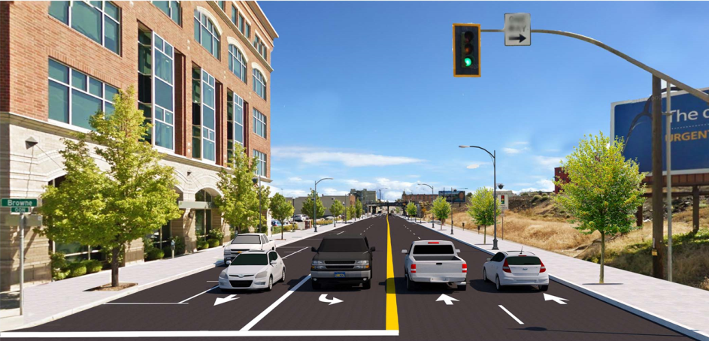
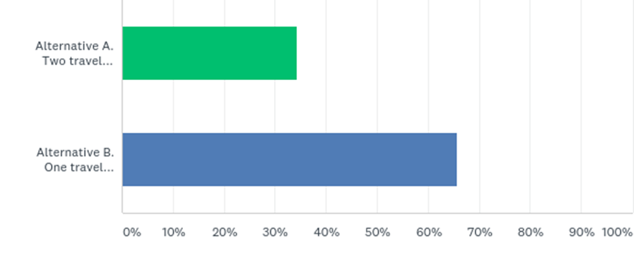
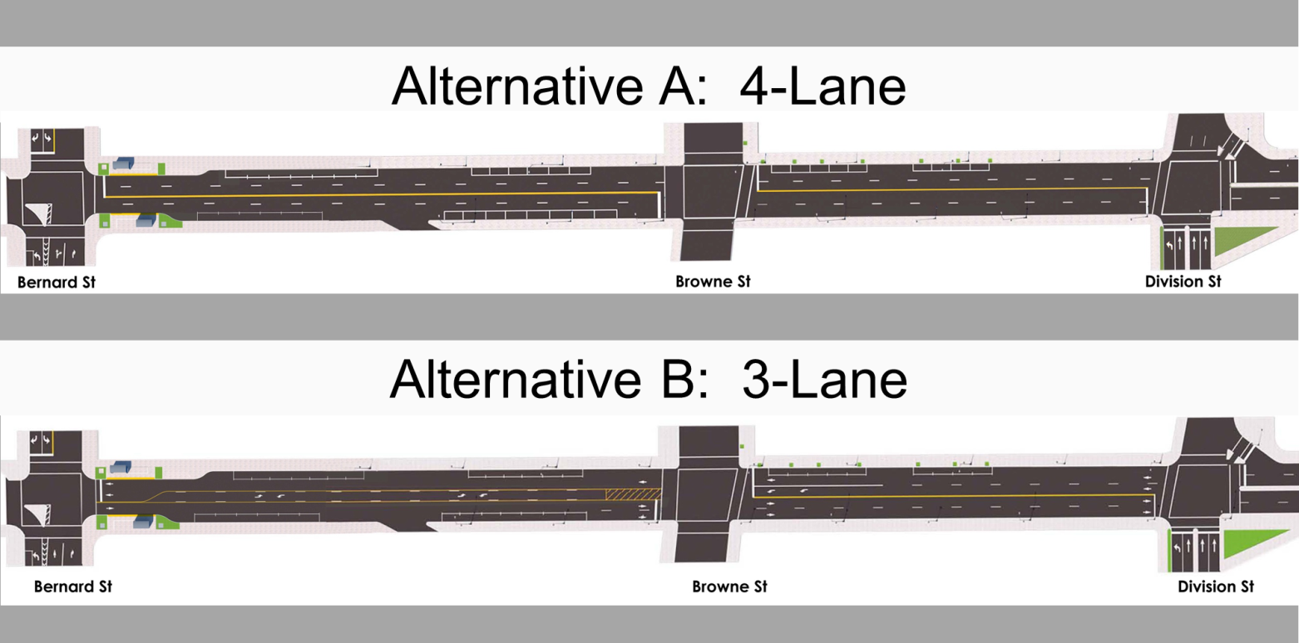
Q3: Which west end alternative do you prefer?
Alternative B

Slide 8
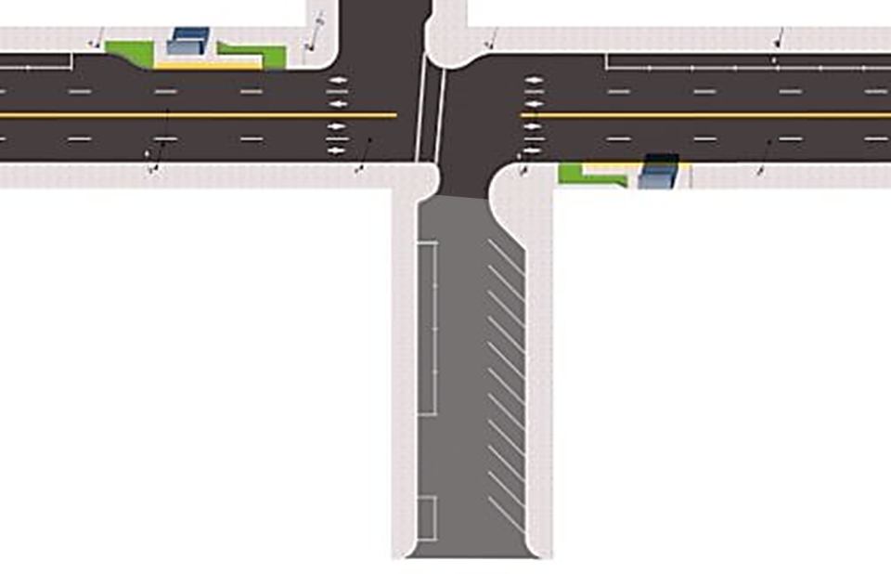
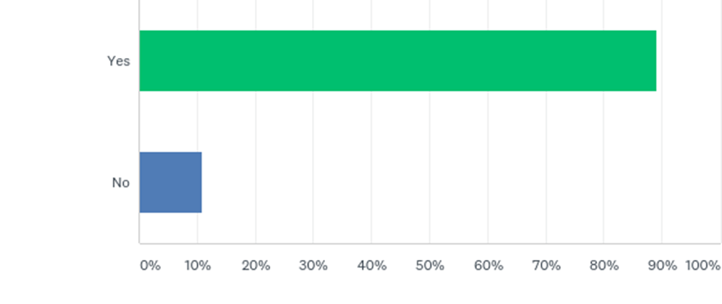
Q5: There is an opportunity to increase the amount of on-street parking by adjusting the use of space on the wider side-streets to include angled parking. Are you in favor of including additional side-street parking?
May Apply to:
Pine St.
Cowley St.
Grant St.
Hatch St.
Scott St.

Slide 9
Transit Facilities
Sprague Avenue is (and will be) a 3-lane section roadway.
The commitment to facilitate transit coach stops in-lane continues to be notably difficult for the public to accept.
An idea from the public meeting is to provide a “pressure relief” similar to school buses pulling off in more rural areas.
There is an opportunity to incorporate a pull-out east of Scott Street and at the same time enhance a crosswalk for the Pride Prep School.

Slide 10
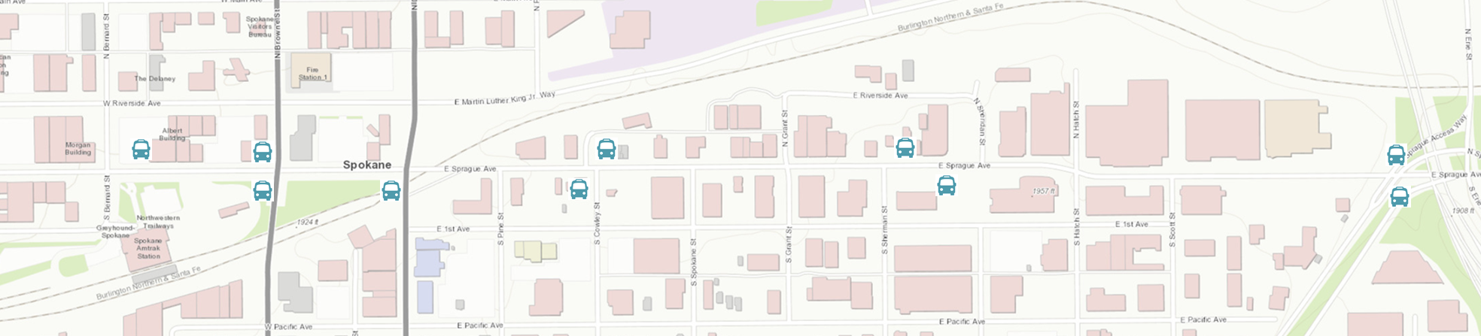




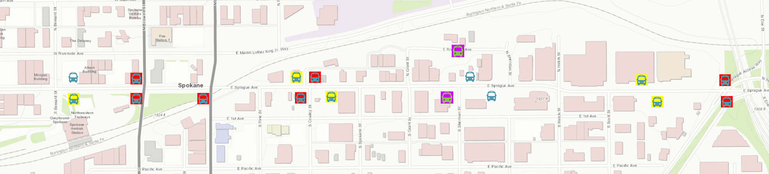
Existing STA Rt 90 Stop
Rt 90 Removal
Relief Pull-Out Stop
Rt 90 New
Medical Shuttle New

Slide 11
Constructability Timeframe
Funding was recommended by UDRA, to be matched by Arterial Street Funds for 2019 Construction
Utility work to replace water transmission main and update the sewer mains
Stormwater work will tie in clean-water drain
Data-oriented decisions for constructability
Land Survey for property lines
Basalt bedrock
Retaining walls
Communication fiber trunk-line
Clean water drain
Adjacent property owner utility update needs (side sewers and water taps)
Sidewalk vaults
Railroad coordination
Construction closures coordination with businesses
Intention is to start construction in 2019. Further coordination is required.

Slide 12
Questions?

Slide 13
By Distance
Full Survey

Slide 14
By Distance
0 – 1.5 Miles

Slide 15
By Distance
1.5 – 3 Miles

Slide 16
By Distance
3 – 7 Miles

Slide 17
By Distance
Outside City

Slide 18
Inside City
Outside City

